Slide 1
Civil and Criminal Forfeiture
An Issue Area Primer for the National Foundation for Women Legislators

Slide 2
Table of Contents
What is Civil Asset Forfeiture?
Slide #3
Examples of Civil Asset Forfeiture
Slide #5
Public Sentiment
Slide #6
New Mexico HB 560, A Model Reform Bill
Slide #7
State Comparisons
Slide #8
Best Practices and Principles
Slide #9
*Note: hyperlinks to reports and data can be opened by right clicking and selecting "open hyperlink"*

Slide 3
What is Civil Asset Forfeiture?
The practice called civil asset forfeiture, or simply forfeiture, is a legal means for law enforcement agencies to seize property and funds allegedly used in connection with a crime.
On principle this practice makes sense—seizing funds from drug dealers and using it for law enforcement purposes is a direct way to tip the scales towards law and order in a community.

Slide 4
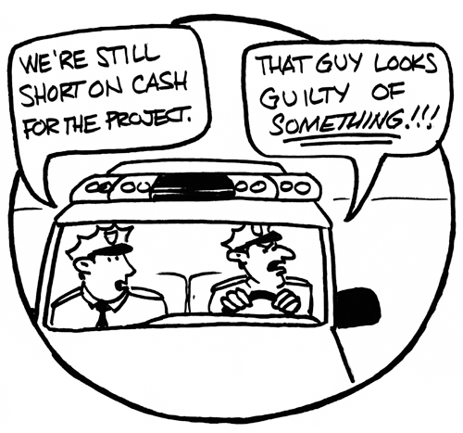
What is Civil Asset Forfeiture?
However, the civil forfeiture system is woefully lacking in checks and balances. In a civil forfeiture the property itself is effectively on trial, not the person whose property it is.
In civil forfeiture proceedings, law enforcement agencies are not required to prove a crime was ever committed—they can effectively take someone’s property on mere suspicion, and once they have it the legal barriers to getting one’s property back are often insurmountable.
Civil forfeiture also often creates a perverse incentive for law enforcement agencies because they are allowed to retain the funds they forfeit.

Slide 5
Examples
Forfeiture in Texas: Research shows forfeiture is occurring more often in rural areas
Watch John Oliver explain forfeiture in action
OK police forfeiting prepaid debit cards
Notes:
Insert hyperlinks to the underlined areas.

Slide 6
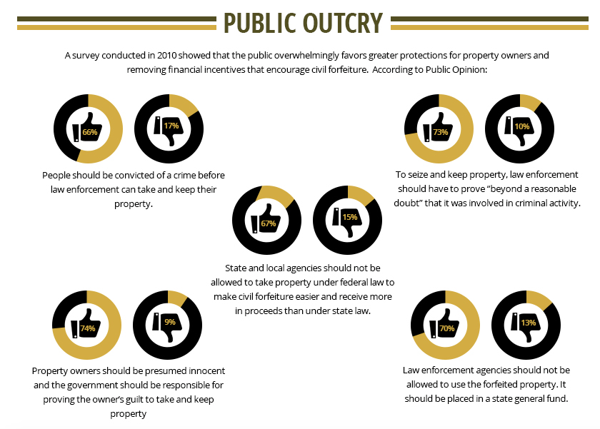
Source: Bill Track 50
It is clear that the public does not favor the current civil asset forfeiture system that is in place and believes that the mechanism should be more closely regulated and reformed.

Slide 7
New Mexico HB 560 A Model Reform Bill
Eliminated civil forfeiture entirely
Requires a criminal conviction before funds or property can be retained by law enforcement agencies
Forfeited funds are required to be sent to the state’s general fund, rather than back to the seizing agency
Limited local law enforcement’s ability to participate in the federal equitable sharing pool

Slide 8
State Comparisons
How does your state handle civil forfeiture?
State by State Comparison

Slide 9
Best Practices and Principles
When law enforcement agencies seek to retain assets or property, they should be required to prove the owner committed a crime
Seized assets should be returned to a state or county’s general fund to remove the incentive for law enforcement to seek funds rather than prevent crime
Law enforcement agencies should be adequately funded through regular budgets
Agencies should be required to collect data on seizures and regularly report or make available that data
There should be strict guidelines on participation in federal equitable sharing to prevent agencies from circumventing state law

