Slide 1
Collateral Consequences
A Criminal Justice Issue Area Primer for the National Foundation for Women Legislators

Slide 2
Table of Contents
Collateral Consequences, Slide #3
Examples, Slides #4, 5
What About Your State?, Slide #6
Best Policy and Practices, Slide #7
*Note: hyperlinks to reports and data can be opened by right clicking and selecting "open hyperlink"*

Slide 3
Collateral Consequences
Collateral consequences of convictions are ongoing and sometimes-permanent restrictions imposed on people convicted of a crime.
While many of these restrictions are good policy, some of them are overly punitive and do nothing to increase public safety.
In fact, some collateral consequences make it nearly impossible for ex-offenders to put their lives back together and re-join society in a productive way.
Source: The Trial Lawyer

Slide 4
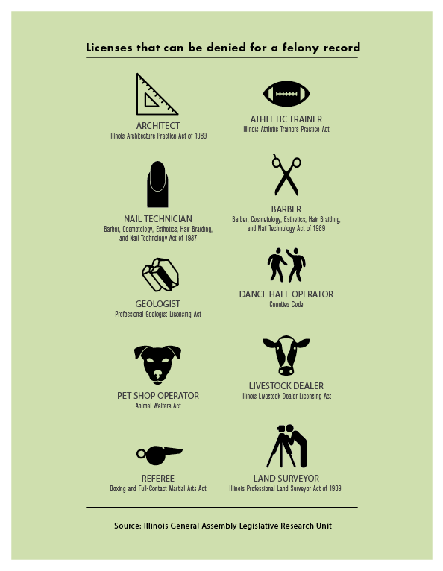
Some Examples
Certain licensed professions often advocate for blanket restrictions on acquiring a license for those with a criminal record.
While this may make good sense for certain professions, it makes less sense for professions like hairbraiding, landscaping, and general service industries.
These restrictions become a barrier to people trying to find work and re-build their lives.

Slide 5
Examples Continued
In many states, access to critical public services like housing and educational loans is severely restricted for those with a criminal record.
Almost all states have some form of sealing or expungement for certain low-level offenses.
However, the process is often arcane, legally technical, and prohibitively expensive.

Slide 6
What about your state?
Many states impose as many as a thousand collateral consequences of conviction.
You can refer to the American Bar Association’s excellent state-by-state resource here.
You can find a repository of resources around collateral consequences and expungement here.

Slide 7
Best Policy and Practices
Restrictions imposed on ex-offenders should serve a clear and demonstrable public safety purpose.
Restrictions should also take into account the known science behind aging and crime – as people age they are less and less likely to commit crime. Therefore permanent restrictions may not always serve public safety.
States should work to streamline the process for sealing or expunging records for those who qualify, and enforce record sealing laws as part of good government practice.
States should reduce or eliminate unnecessary barriers to opportunity and stability for those who have paid their debt to society, especially related to licensing and access to public services.

