Slide 1
How Technology Is (R)evolutionizing Communities

Slide 2
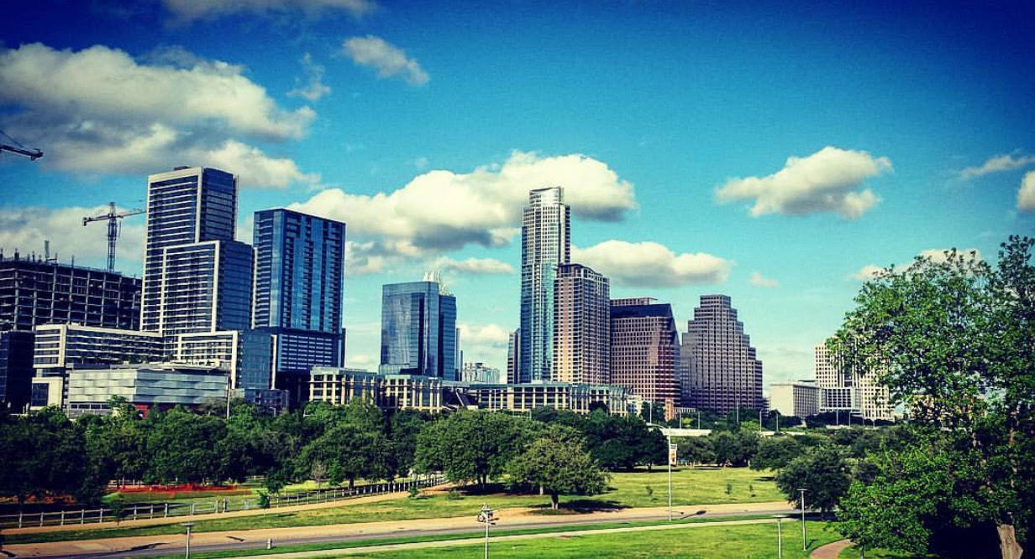
What is a Smart City?
A city that integrates data-driven insights
gathered from connected technology to
(1) improve the efficiency of city operations and
(2) create an optimized, more enjoyable urban experience.
Notes:
Urbanization and technology are rapidly advancing.
Cities operate more efficiently as the cost of running a city increases.
Between 3,000 and 5,000 cities are already on that journey.
Urban life is more connected, convenient, and intuitive.

Slide 3
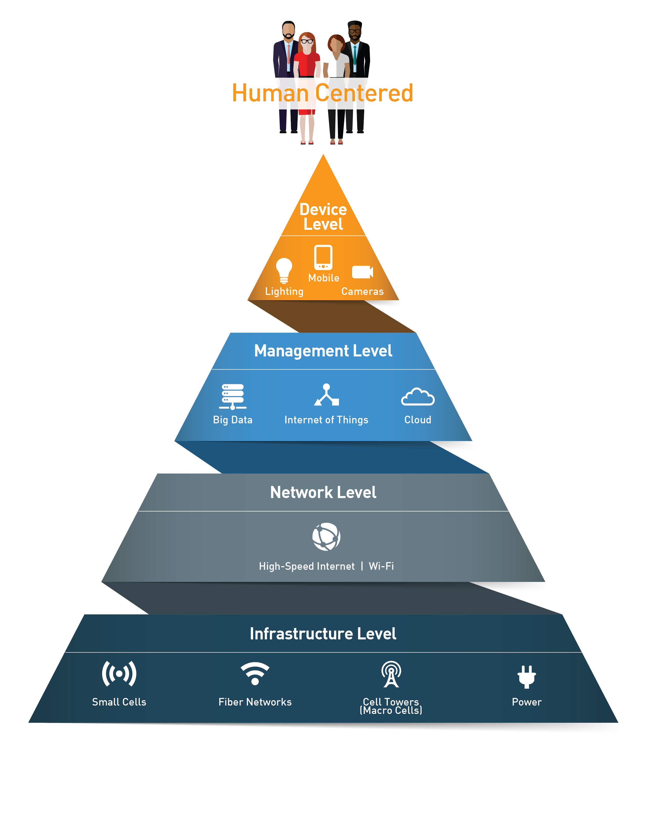
The Four Layers of a Smart City

Slide 4
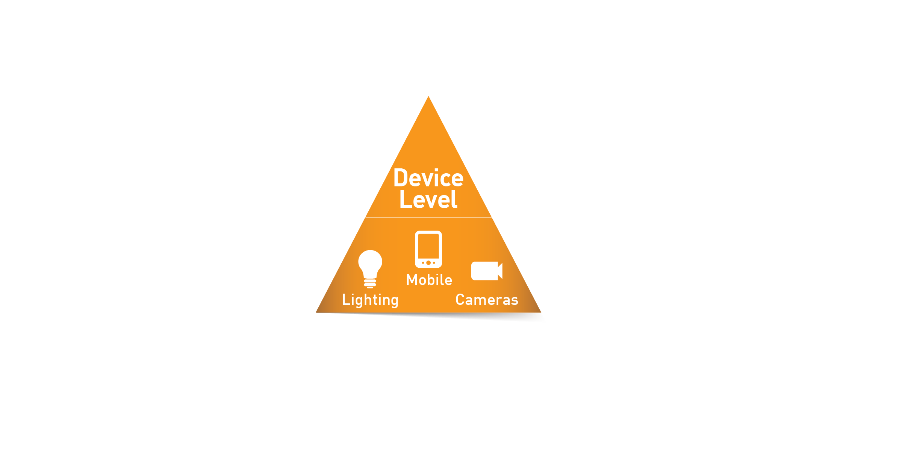
The Device Level
Top and most visible layer
Includes the physical objects that you can see and touch including:
Cameras
Sensors
Beacons
Lighting
Mobile Phones

Slide 5
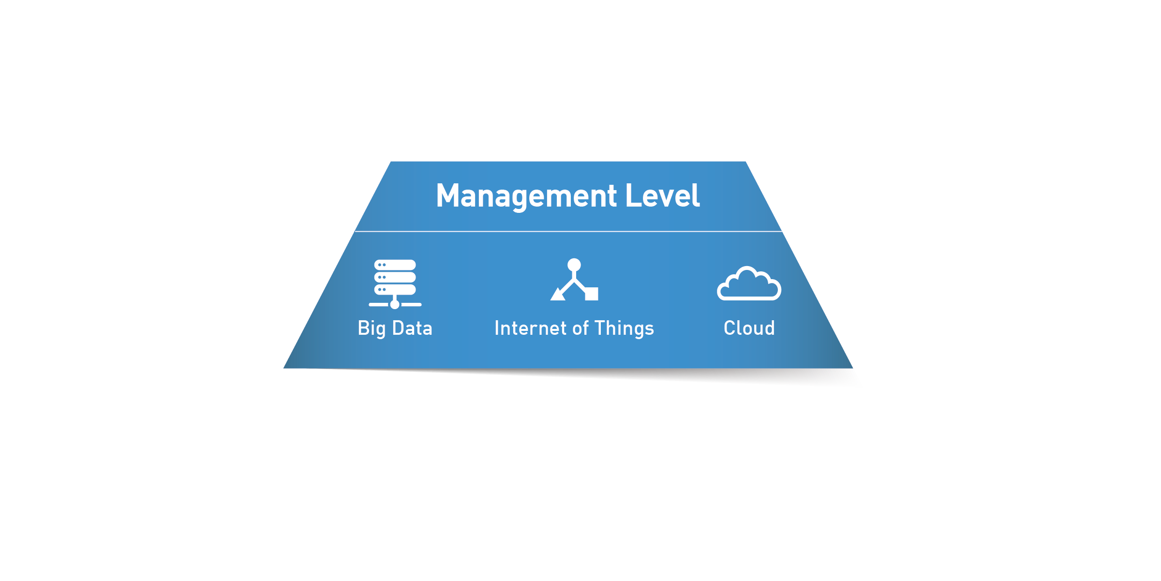
The Management Level
Big Data, the Internet of Things (IoT), the Cloud
This is where info collected at the Device Level is collected, managed, secured, stored and shared

Slide 6
The Network Level
Activity happening on the Device Level and the Management Level is causing online activity to skyrocket on this level
Smart city leaders are boosting network capacity to 5G levels by placing “small cells” throughout the city landscape

Slide 7
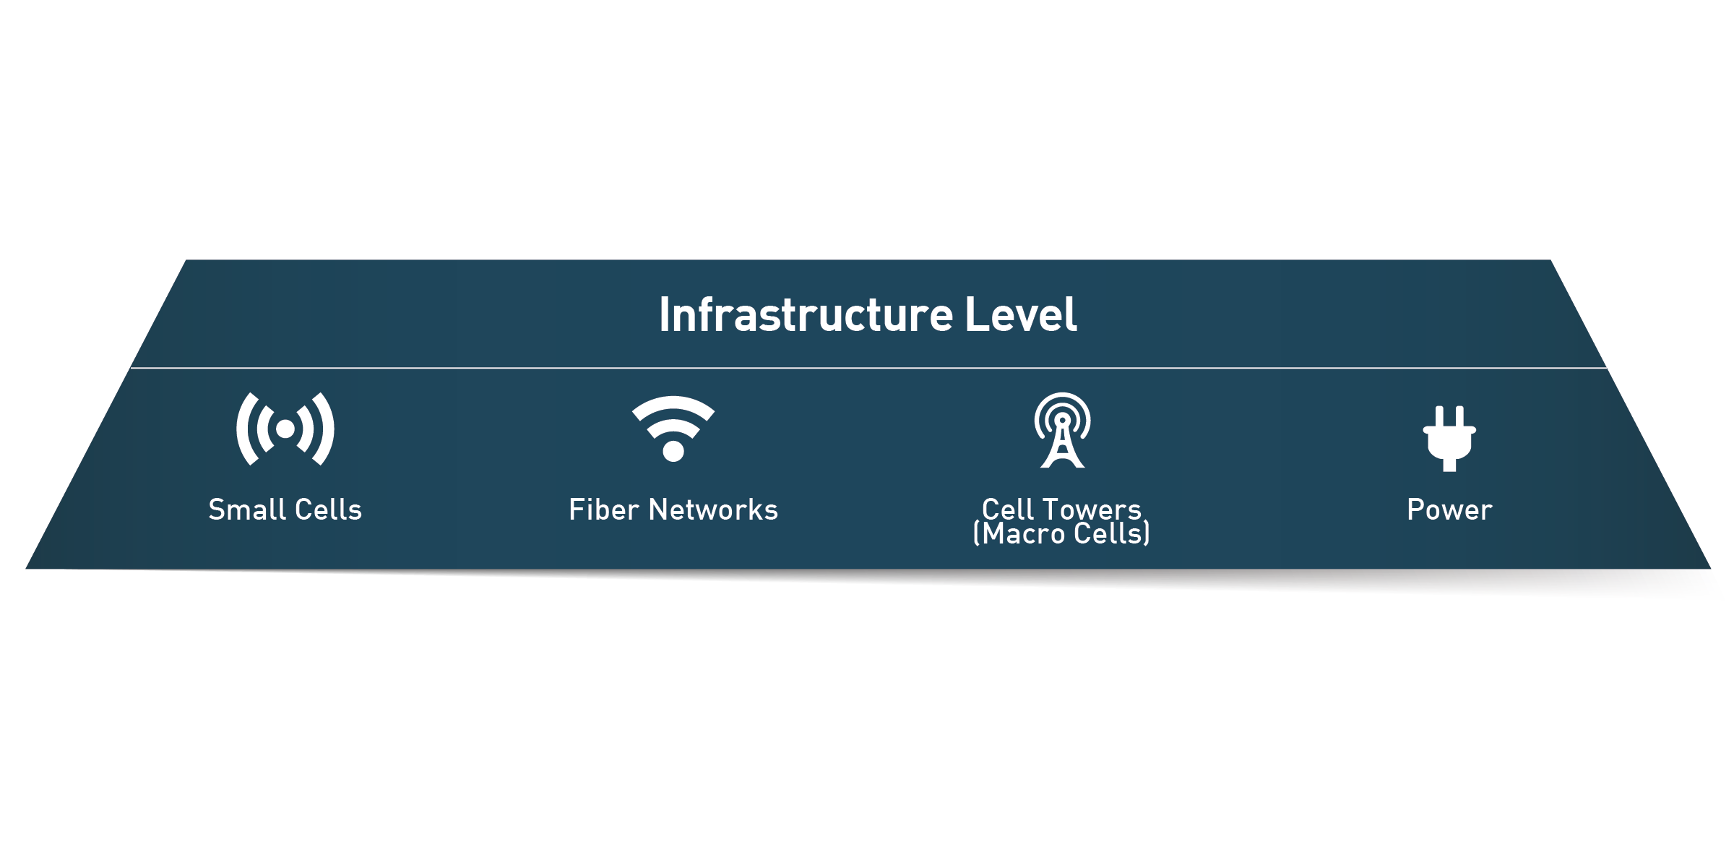
The Infrastructure Level
Small cells, fiber networks, cell towers and power grids serve as the foundation on which everything else runs
The Infrastructure Level makes connection possible

Slide 8
A Smart City Ecosystem
START UPS
NIMBLE INNOVATION
GOVERNMENT
LOCAL/COUNTY/STATE/FEDERAL
CORPORATIONS
> POLICY
> REGULATIONS
> CIVIC PRIORITIES
INFRASTRUCTURE + INVESTMENT
UNIVERSITIES/3rd PARTIES
R&D + TALENT + SAFE SPACE
Notes:
One of the critical elements of creating smart cities is the establishment of an ecosystem where there is communication and participation from multiple stakeholders. The public sector (government) is the ultimate decision maker as to how technology is integrated into city operations. The private sector (start ups and corporations) provides innovation solutions and resources. Third party organizations (including nonprofits, universities, etc) are also critical conveners and act as "safe spaces" for the public and private sector to experiment with different approaches and pilot projects.

Slide 9
How Will Smart Cities Technologies Impact:
Community Equity
Economic Development
Mobility + Transportation
Sustainability
(Clean + Green)
Workforce Development
Autonomous Vehicles
Energy Conservation
Education
Ride Sharing
Notes:
Ultimately, smart cities are focused on how to improve the urban experience for all residents, citizens and visitors. These broad categories can help focus the conversation around what the highest priorities are for a specific community. It is possible to give attention to each of these areas, but the most successful smart cities rank projects and build a supportive platform that can then be applied to all civic challenges.

