Slide 1
Treatment Access A Substance Use Disorder Perspective
National Foundation for Women Legislators
September 22, 2017
Alaina McBournie, Principal Associate | Substance Use Prevention and Treatment Initiative

Slide 2
Reduce the inappropriate use of prescription opioids while ensuring that patients with medical needs have access to pain control, and
Expand access to effective treatment for substance use disorders, including medication-assisted treatment.

Slide 3
Presentation Outline
Overview of Opioid Use Disorders (OUD)
Evidence-Based Treatment
Barriers and Solutions to Improve Treatment Access

Slide 4
SOURCE: SAMHSA, Center for Behavioral Health Statistics and Quality, National Survey on Drug Use and Health (NSDUH), 2015.; Facing Addiction Action Network, https://www.facingaddiction.org/home/fact-16-surgeongeneral-stat.

Slide 5
Opioid Use Disorder…
is a complex disease that results in chemical and physiologic changes to the brain
must be treated like any other chronic, relapsing condition

Slide 6
Medication-Assisted Treatment (MAT) is Effective
Medication-assisted treatment increases adherence and reduces:
Illicit opioid use
Overdose risk and fatalities
Health care utilization
Criminal activity
Mattick RP et al., 2009;3:CD002209; Comer SD et al. JAMA Psych. 2006;63:210-8; Fudala PJ et al., NEJM. 2003;10:949-58;
Schwartz RP et al. AJPH. 2013;103,917-22;. Tsui JI et al. JAMA Intern Med. 2014;174:1974-81; Metzger DS et al., J Acquir Immune Defic Syndr. 1993;6:1049-56.

Slide 7
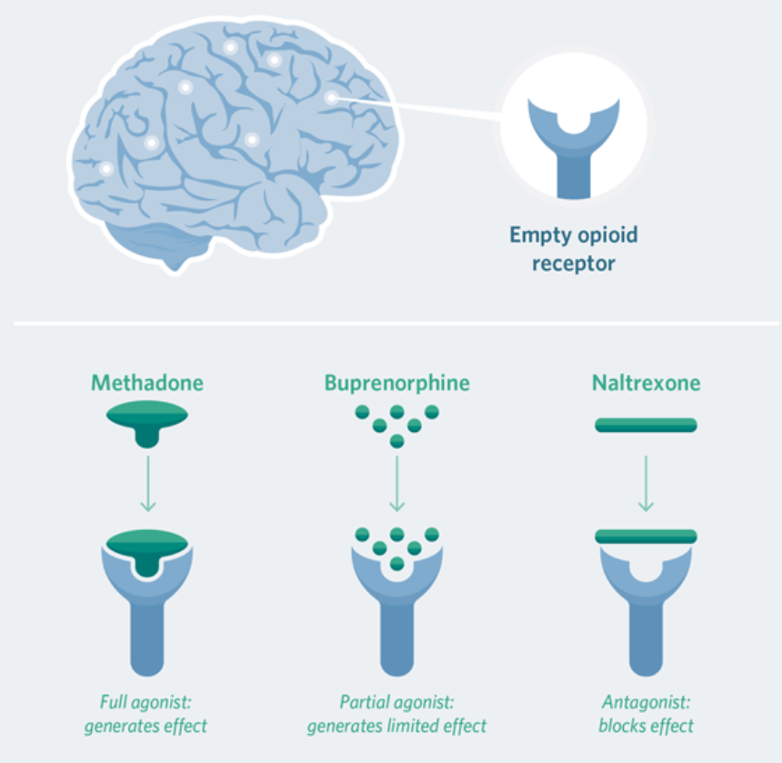
Medications for Opioid Use Disorder
The Pew Charitable Trusts, “http://www.pewtrusts.org/en/research-and-analysis/fact-sheets/2016/11/medication-assisted-treatment-improves-outcomes-for-patients-with-opioid-use-disorder.

Slide 8
Behavioral Therapies for Opioid Use Disorder
Goals
Modify underlying behaviors that lead to misuse
Support medication adherence
Example cognitive behavioral therapies
Individual or group counseling
Family therapy
Mutual help programs

Slide 9
Guidelines from the American Society of Addiction Medicine (ASAM)
Recommend coverage for:
FDA-approved drugs
Counseling and long-term recovery supports
Guidelines address:
Disease severity
Setting of care
http://www.asam.org/quality-practice/guidelines-and-consensus-documents/npg/pocket-guide-and-app

Slide 10
ASAM Criteria Use Disease Severity to Determine Treatment Needs
.5
Early Intervention
1
Outpatient Treatment
2
Intensive Outpatient and Partial Hospitalization
3
Residential/Inpatient Treatment
4
Medically-Managed Intensive Inpatient Treatment
SOURCE: American Society of Addiction Medicine http://www.asam.org/quality-practice/guidelines-and-consensus-documents/the-asam-criteria/about

Slide 11
In practice, many public and private payers fail to cover all of the care recommended by the ASAM guidelines.

Slide 12
Medicaid Programs in 19 States Do Not Cover All Drugs for Opioid Use Disorder
Colleen M. Grogan et al., “Survey Highlights Differences In Medicaid Coverage For Substance Use Disorder Treatment And Opioid Use Disorder Medications,” Health Affairs 35, no. 12 (2016), http://content.healthaffairs.org/content/35/12/2289.full.

Slide 13
Residential Treatment is Often Not Covered by Medicaid
ASAM Levels of Care Coverage
All Levels Covered
Missing One or More Levels
Source: Colleen M. Grogan et al., “Survey Highlights Differences In Medicaid Coverage For Substance Use Disorder Treatment And Opioid Use Disorder Medications,” Health Affairs 35, no. 12 (2016), http://content.healthaffairs.org/content/35/12/2289.full.

Slide 14
Barriers to an Effective Treatment System
Coverage Gaps
Treatment Infrastructure
Funding

Slide 15
The GOAL is…
an effective treatment system that provides timely access to comprehensive and evidence-based care.

Slide 16
Summary
Opioid use disorder is a chronic disease
A comprehensive and evidence-based treatment approach is needed
Medication-assisted treatment is effective, but barriers exist
Access to effective treatment requires input from patients, clinicians, insurers, and state and federal policymakers

Slide 17
ALAINA MCBOURNIE
amcbournie@pewtrusts.org
202-540-6967
www.pewtrusts.org/substancemisuse

